Slide 1


NUS ISY5002 Team Eagle Project Update
Sep 26, 2022
Nair Prashant Chathuar Balachandran A0249268N
Nakahara Hirotoshi, A0232336M
Pradeep Janakiraman, A0140188H
Vikram Sankireddypally A0249306A

Slide 2
Executive summary
Background
What we do in the project
Video analytics is important because of following reasons:
Improvement of internet access across the globe
Penetration of social media such as Facebook, Instagram, YouTube and TikTok
Growth of the online advertising industry. The size is $556 bn in 2021 and expected to grow to $616 bn in 2022
Measurement of quality of videos is a crucial theme for the monetisation
More consumer watch duration, creators or advertisers can expect more benefit from the video exposures
However, the existing products may not be enough because of:
Only using metadata (example)
No implication about video contents in terms of creative things creators can control
We will design and demonstrate a system to predict following metrics of YouTube videos:
view counts
To do that, we utilise following tools and technologies:
youtube-dl API to download YouTube videos and the metadata
FF mpeg tool to cut the videos into sliced images
Vision API to extract information
Based on the above input data, we will design a deep-learning model to predict the metrics
Input data (X): thumnails, sliced video images, object data on the sliced images
Output data (y): view counts and like counts
Structure: combination of different DL models such as LSTM, CNN
Limit the video categories within dog and cat for the simplicity

Slide 3
The product design
Unstructured data (sliced images, thumbnail)
youtube-dl (API to download metadata, videos)
Cloud storage
(G-drive)
Feedback
Video cutting (FF mpeg)
Vision API with Python
structure data (object name etc.)
Deep learning model
Prediction (view counts, like counts)
URL list
(YouTube Boundary box data set)
Model Training (batch)
Apply a Google trained model to generate unstructured/structured data to use it as input for our DL model
Dog 541 videos
Cat 713 videos
Meta data (View counts, post date etc.)
Apply a Google trained model to generate input for the prediction
Model update
Image data (with bbox)
Video post (with thumbnail)
Video cutting (FF mpeg)
Vision API with Python
Deep learning model
View/like counts prediction
Front App
Structure data (object name etc.)
Apply the trained model to provide prediction

Slide 4
Data overview
Data category
Description
Data source
How to get the data
Data volume
Thumbnail *1
Thumbnail image file of a video
YouTube video
Download thumbnails/videos by using youtube-dl API based on the URL list of dog and cat category in YouTube boundary box dataset
Videos are sliced by using FF mpeg package
1,208 images
Sliced video images
Sliced images of a video
YouTube video
1,208 videos (22,307 images = 8,660 cat images + 13,647 dog images)
Input X
Object data in the sliced images
csv file which columns are object names, confidence
csv file generated by Vision API
csv file generated by Vision API (please see the next page)
1,208 rows x 10 columns (8 extracted information,YouTube id , another number from file name)
View counts
View counts of a video
YouTube metadata
Download metadata by using youtube-dl API based on the URL list of dog and cat category in YouTube boundary box dataset
1,208 rows x 3 columns (video_id, view counts, like counts)
Output y
Like counts
Like counts of a video
YouTube metadata

Slide 5
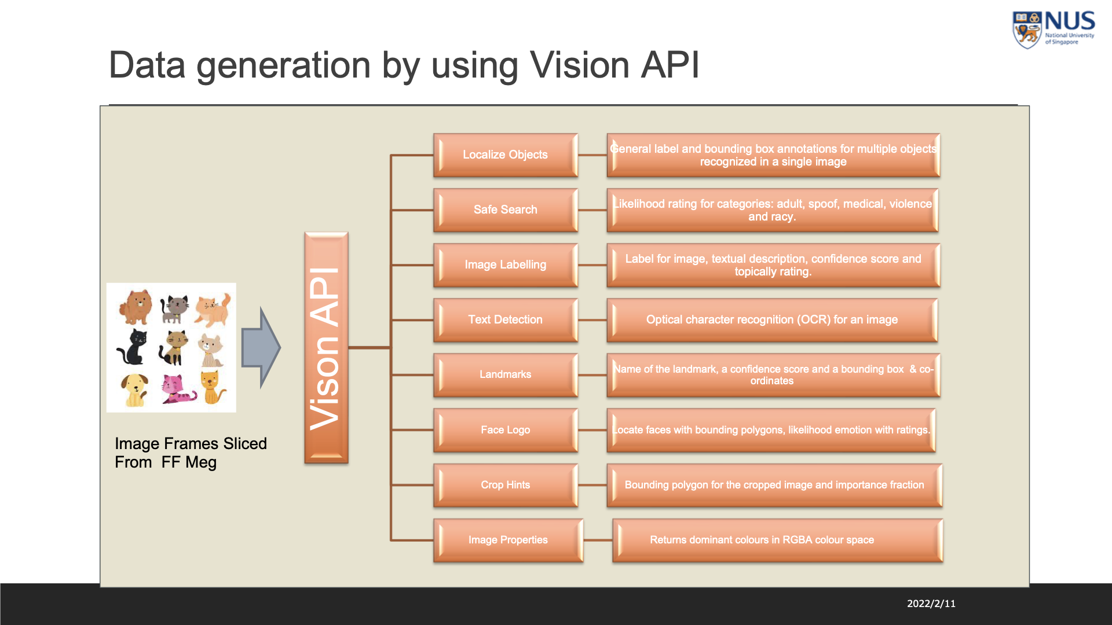

Slide 6
Deep learning model overview
Prashant/Pradeep to create

Slide 7
Schedule and Role & Responsibilities
Task
Lead
Contri- butor
Sep 5
Sep 12
Sep 19
Sep 26
Oct 3
Oct 10
Oct 17
Oct 24
Oct 31
Data download
Hiro
Vikram
Video data download
Meta data /thumbnail download
Data engineering
Video cutting
Hiro
Vikram
Video cutting
Data engineering for the model improvement (if any)
Data extraction by Vision API
Vikram
Hiro
API test
Data extraction from sliced images
DL model creation
Prashant
All
Draft DL structure
First model creation
DL model creation
DL model validation/ improvement
Pradeep
Model improvement
Model deployment(UI)
Vikram
Hiro
Deployment of the model
Test
Test
Pradeep
Prashant
Prediction with the test videos
Report/presentation creation
All
Report & presentation creation

Slide 8
Remaining issues and discussion points
Issue 1: Prediction of view counts and like counts exactly may be too challenging.
We may consider changing the problem to classification problem (e.g., predict “view counts > 10,000” or “view counts <= 10,000”)
Issue 2: xxxx
xxxx
xxxx
Issue 3: xxxx
xxxx
xxxx

Slide 9
Deep learning model overview
Thumbnails
CNN
Concatenate
Dense
Sliced images
LSTM or shared CNN
View counts
Metadata

